Slide 1




Module 13 – Standards
Training Modules for Applying the Mitigation Hierarchy:
Planning Policy and Projects for No Net Loss or a Net Gain of Biodiversity
Module 13
Standards

Slide 2
Standards Module – Abstract
One of the principal drivers for developers to apply the mitigation hierarchy rigorously and plan for No Net Loss and Biodiversity Net Gain is the set of standards, including financial performance standards and loan conditions applied by financial institutions. This module explores four sets of standards and policies that are shaping international practice on the mitigation hierarchy around the world.
First, the module introduces Performance Standard 6 of the International Finance Corporation (IFC PS6), also adopted by 99 financial institutions in 37 countries which are members of the Equator Principles Association.
Then it covers the World Bank’s Environmental and Social Standards (especially number 6), which apply to governments and have many similarities to PS6.
Next, the module explains the BBOP Principles, Standard and resources, which have shaped international best practice and have been applied by the COMBO Project.
Finally, the module discussed IUCN’s Policy on Biodiversity Offsets.

Slide 3
Module on Standards – Contents
Contents | Slides
Introduction | 4
International Finance Corporation Performance Standard 6 (IFC PS 6) | 5-12
World Bank Environmental and Social Standard 6 | 13-15
BBOP Principles, Standard and resources | 16-33
IUCN Policy on Biodiversity Offsets | 34-37
Take home messages | 38

Slide 4



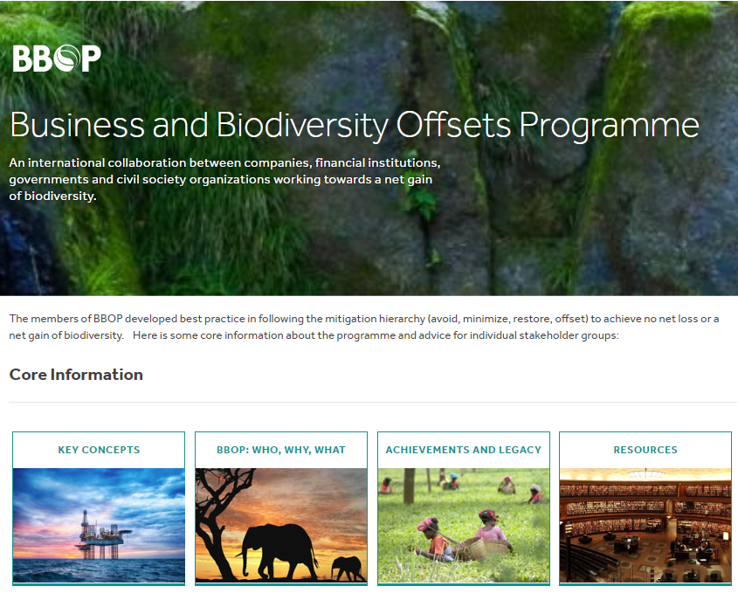
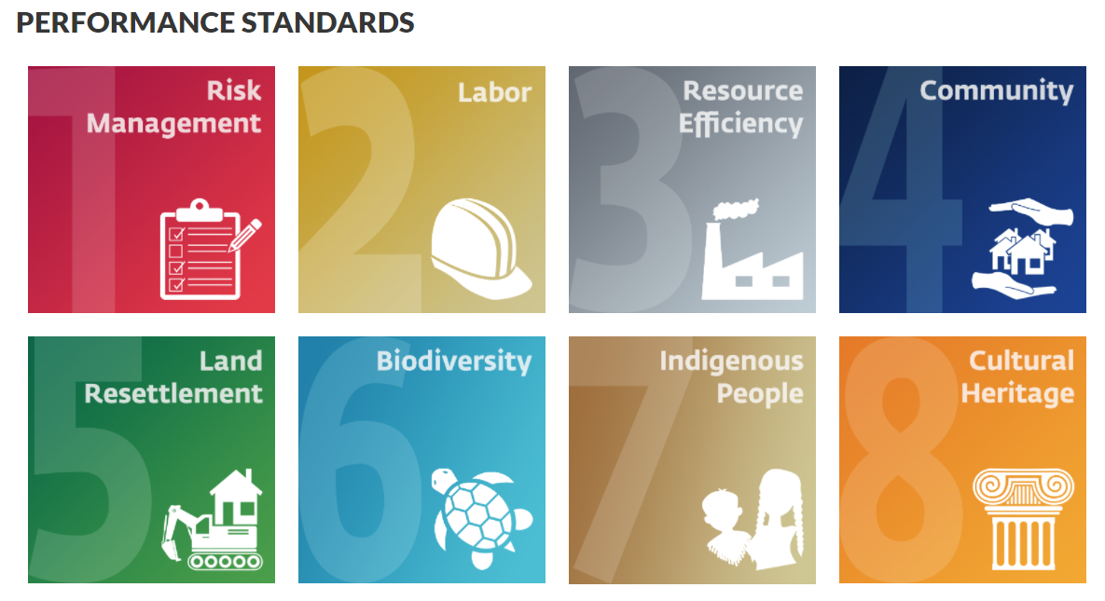

Standards
2016 Biodiversity Offset Policy
2012 IFC Performance Standards, incl. on Biodiversity (PS6)
2012 BBOP Principles, Biodiversity Offset Standard, Guidance notes and other resources
2016 Environmental and Social Framework, including Biodiversity Safeguards ESS 6 (2018)

Slide 5
Standards
IFC

Slide 6

Standards
International Finance Corporation Performance Standard 6 (IFC PS 6):
Biodiversity Conservation and Sustainable Management of Living Natural Resources

Slide 7
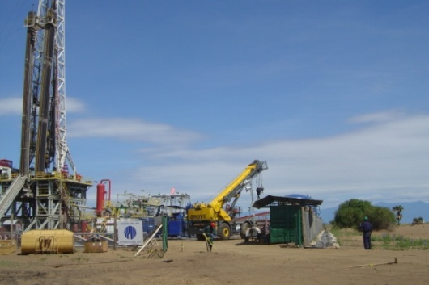
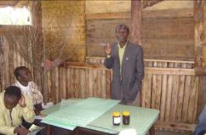


IFC-Performance Standard 6
Natural Habitat: no net loss, where feasible
Critical Habitat: net gains
PS 6 on Biodiversity Offsets:
Measurable conservation outcomes reasonably expected to result in no net loss and preferably a net gain of biodiversity. Net gain is required in critical habitats.
The design of a biodiversity offset must adhere to the “like-for-like or better” principle.
Must be carried out in alignment with best available information and current practices.
External experts with knowledge in offset design and implementation must be involved.
Guidance Note 6 references the BBOP Principles as an internationally recognized standard in biodiversity offset design.

Slide 8

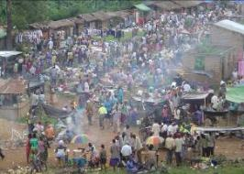
About IFC-PS6
Objectives:
Protect and conserve biodiversity;
Maintain the benefits from ecosystem services;
Promote sustainable management of Natural Living Resources.
For projects:
Located in modified, natural or critical habitats;
Which potentially impact on or are dependent on ES over which client has direct management control or significant influence;
Including production of living natural resources (eg agriculture, husbandry, fisheries, forests).

Slide 9

IFC PS6: Natural habitat
Areas composed of viable assemblages of plant and/or animal species of largely native origin, and/or where human activity has not essentially modified an area’s primary ecological functions and species composition.
Client will not significantly convert or degrade natural habitats, unless all of the following have been demonstrated:
No other viable alternatives within the region exist for development of the project on modified habitat;
Consultation has established the views of stakeholders, including Affected Communities, with respect to the extent of conversion and degradation; and
Any conversion or degradation mitigated according to the mitigation hierarchy.
In areas of natural habitat, mitigation measures will be designed to achieve no net loss of biodiversity where feasible. Appropriate actions include:
Avoiding impacts on biodiversity through the identification and protection of set-asides;
Implementing measures to minimise habitat fragmentation, such as biological corridors;
Restoring habitats during operations and/or after operations; and
Implementing biodiversity offsets.

Slide 10

IFC PS6: Critical habitat
Areas with high biodiversity value, including:
habitat of significant importance to Critically Endangered and/or Endangered species;
habitat of significant importance to endemic and/or restricted-range species;
habitat supporting globally significant concentrations of migratory species and/or congregatory species;
highly threatened and/or unique ecosystems; and/or
areas associated with key evolutionary processes.

Slide 11
IFC PS6: Critical habitat
No project unless client has demonstrated:
No other viable alternatives within the region exist for development of the project on modified or natural habitats that are not critical;
Project doesn’t lead to measurable adverse impacts on biodiversity values for which critical habitat designated and on ecological processes supporting them;
Project doesn’t lead to net reduction in the global and/or national/regional population of any Critically Endangered or Endangered species over a reasonable period of time; and
Robust, appropriately designed, and long-term biodiversity monitoring and evaluation program is integrated into the client’s management program.
In cases where a client can meet these requirements, the project’s mitigation strategy will be described in a Biodiversity Action Plan and will be designed to achieve net gains of those biodiversity values for which critical habitat was designated.
Where biodiversity offsets are proposed, client must demonstrate through an assessment that the project’s significant residual impacts on biodiversity will be mitigated to meet the above requirements.

Slide 12



Revision of IFC-PS and Equator Principles
The Equator Principles are based on the International Finance Corporation (IFC) Performance Standards (PS) – revised in 2012.
99 banks and financial institutions operating in 37 countries have adopted the ‘Equator Principles’, embracing the IFC Performance Standards.
This covers majority international project finance debt in emerging markets.
Clients of Equator Bank and IFC clients seeking total project capital costs of over $10 million must comply with loan conditions, including environmental and social ‘performance standards’ (PS).
Notes:
There are currently 99 adopting financial institutions in 37 countries, as of 4 November 2019.
https://equator-principles.com/members-reporting/

Slide 13
Standards
World Bank

Slide 14
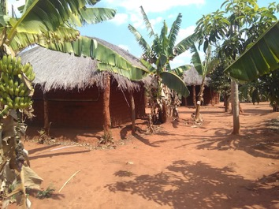
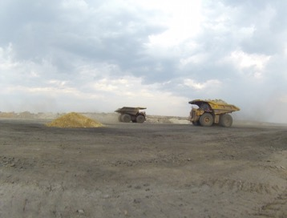
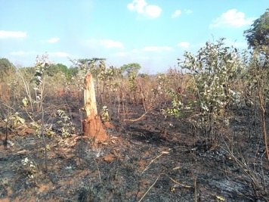
World Bank Safeguards policies
New Safeguards adopted
The World Bank approved the new Environmental and Social Framework on 4 August 2016, to be applied from 2018 onwards. This follows a two-year process to review and update the Bank’s Environmental and Social Safeguard (ESS) policies.
ESS6: Biodiversity Conservation and Sustainable Management of Living Natural Resources
Mitigation hierarchy is central – stress on avoidance
Competent expert
Biodiversity Management Plan
Differentiated risk management ‘natural’, ‘modified’, ‘critical’, ‘protected’.
Biodiversity offsets as last resort
No Net Loss and preferably Net Gain

Slide 15

World Bank Safeguards policies
Results
More specific and stringent requirements with drafts substantially revised during the process.
Now more closely aligned with IFC PS (e.g. WB ESS6 and includes provisions relating to forests and natural habitats, etc.)
Main limitation is that WB permits national standards to be applied, even if these are weaker than the WB Safeguards
Notes:
See: https://www.worldbank.org/en/projects-operations/environmental-and-social-framework/brief/environmental-and-social-standards
http://pubdocs.worldbank.org/en/837721522762050108/Environmental-and-Social-Framework.pdf#page=81&zoom=80

Slide 16
Standards
BBOP

Slide 17

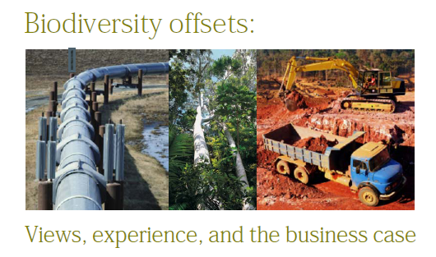
Why was BBOP set up?
Interviews in 2003 by Insight Investment and IUCN. Need for:
  Multistakeholder, international forum to discuss the mitigation hierarchy, especially offsets
  Pilot projects
  Methodologies and guidance
  Enabling policy framework
Notes:
Following the mitigation hierarchy demands a sophisticated approach to handling risk and opportunity and raises a number of questions: How much to invest in rerouting a pipeline or setting aside a piece of land or sea that could be developed? Who to involve and how to secure long term sustainable development objectives once a project has closed? How to measure impacts on biodiversity and dependence on ecosystem services? Whether to get involved in activities outside the company’s main zone of influence? How to tackle multiple inter-connected issues such as biodiversity, carbon, water, and poverty alleviation? How to work with governments, particularly at the regional and local levels, when they too are coming to terms with these new challenges?
When BBOP was established, it was hard to answer these questions. Prescriptive approaches could not be flexible enough to fit many different situations, yet there were no internationally recognized principles to apply in a broad range of settings. Biodiversity was often overlooked in the impact assessment process. There was no common understanding of what was meant by a ‘biodiversity offset’, when offsetting was appropriate and how to distinguish between good and bad practice in following the mitigation hierarchy. BBOP was set up to change that.

Slide 18
Why was BBOP set up?
Changing societal expectations about biodiversity mitigation.
Company risk and opportunity, need for advice and partnerships.
Confusion and misunderstanding with varied terminology.
Guidelines, methodologies and standards were lacking.
Methods hadn’t been tested at pilot sites.
Government policies and financial investment conditions did not encourage best practice.
No recognized standard, so no way to judge the quality of mitigation.
Risk of criticism for developers.
No forum to bring stakeholders together
Established to address this.
Notes:
Following the mitigation hierarchy demands a sophisticated approach to handling risk and opportunity and raises a number of questions: How much to invest in rerouting a pipeline or setting aside a piece of land or sea that could be developed? Who to involve and how to secure long term sustainable development objectives once a project has closed? How to measure impacts on biodiversity and dependence on ecosystem services? Whether to get involved in activities outside the company’s main zone of influence? How to tackle multiple inter-connected issues such as biodiversity, carbon, water, and poverty alleviation? How to work with governments, particularly at the regional and local levels, when they too are coming to terms with these new challenges?
When BBOP was established, it was hard to answer these questions. Prescriptive approaches could not be flexible enough to fit many different situations, yet there were no internationally recognized principles to apply in a broad range of settings. Biodiversity was often overlooked in the impact assessment process. There was no common understanding of what was meant by a ‘biodiversity offset’, when offsetting was appropriate and how to distinguish between good and bad practice in following the mitigation hierarchy. BBOP was set up to change that.

Slide 19

Changing expectations: new social compact
Historically:
Environmental and social impacts of development tolerated for: economic growth, GDP, jobs, royalties, infrastructure
New expectations:
  Some areas ‘off limits’ for development
  Presumption of environment vs development trade-off gone:
  Social and environmental benefits AND economic growth etc.
  Specifically: no net loss or net gain of biodiversity
  Greater rigour with the mitigation hierarchy.

Slide 20

What was BBOP?
15 years of global, multi-stakeholder agreement and experience: 100 companies, financial institutions, government agencies, NGOs, research organisations, individuals.
Aim: Help developers, financial institutions, governments, conservation groups and communities develop and apply best practice towards achieving no net loss and preferably a net gain of biodiversity through the thorough application of the mitigation hierarchy.
Basis: agreed principles and on-the-ground experience.
BBOP ran from 2004-2018.
Products: BBOP developed, agreed and tested principles, a standard, and many tools for decision-makers and practitioners in business, government and civil society.
Notes:
BBOP programme was a collaboration between some 100 organisations: companies, government agencies, conservation organizations and financial institutions from around the world, as well as some independent experts.
The aim of BBOP was to develop shared views and experience of best practice in following the mitigation hierarchy and demonstrating ‘no net loss’ or a ‘net gain’ of biodiversity, including through the use of biodiversity offsets.
The BBOP Advisory Group members represented groups in society with diverse perspectives on environment and development from many different countries.

Slide 21
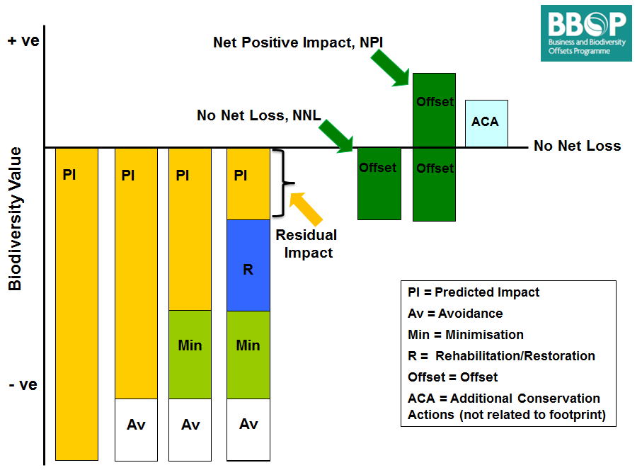
BBOP: vision
BBOP Vision:
  The mitigation hierarchy is rigorously applied worldwide to a high standard, to achieve no net loss and preferably a net gain of biodiversity
Avoid, minimise, restore, and finally offset residual impacts

Slide 22

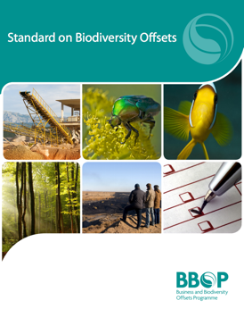
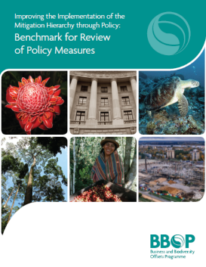
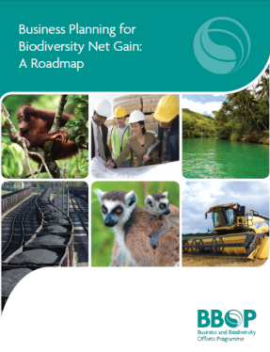

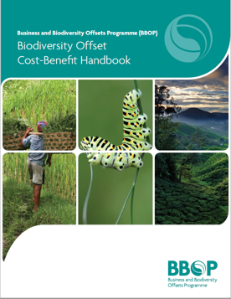
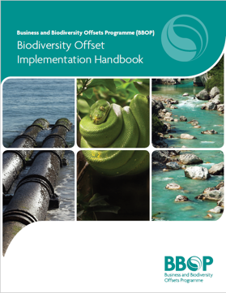
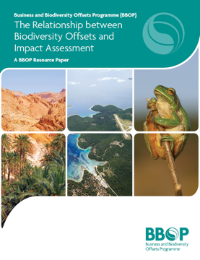
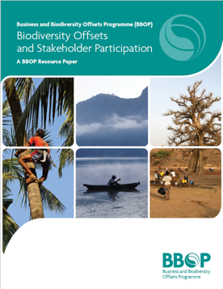
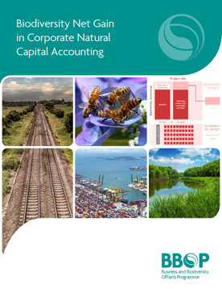

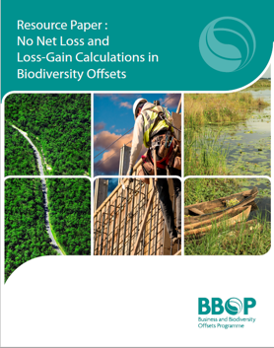
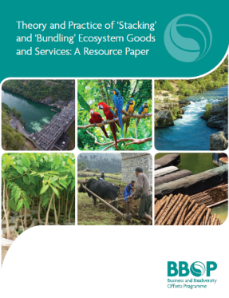
BBOP: tools for delivery & links to COMBO training
BBOP Products | COMBO Modules using these
Principles & Standard on Biodiversity Offsets | This module
Roadmap for Business and Roadmap for Government | ‘Business Roadmap’ and ‘Government Roadmap’ modules
Handbooks | See modules on ‘Key concepts for mitigation’ and ‘Metrics’
Resource Papers | See modules on ‘Key concepts for mitigation’ and ‘Metrics’
Case studies | Throughout this course, including the modules on project example, system example and exercises
http://bbop.forest-trends.org/

Slide 23
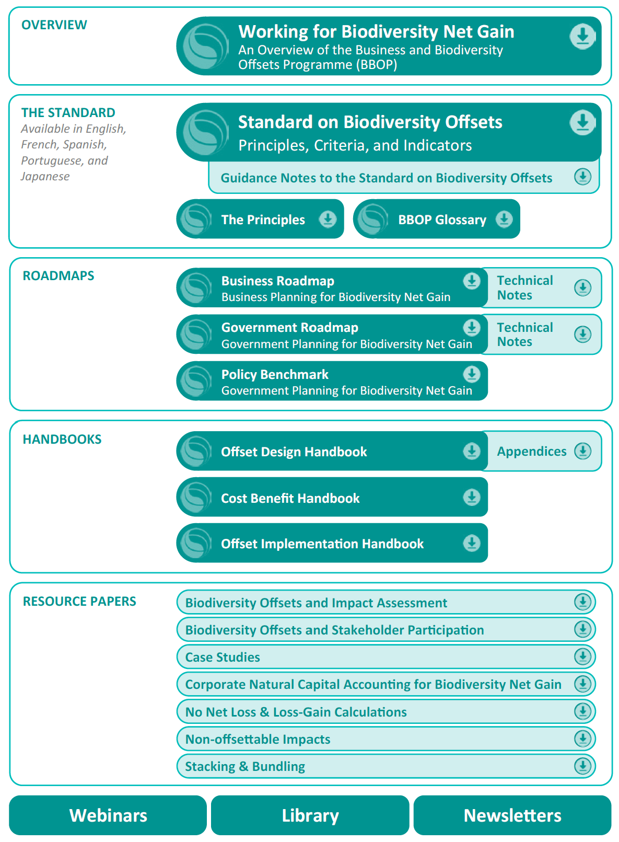

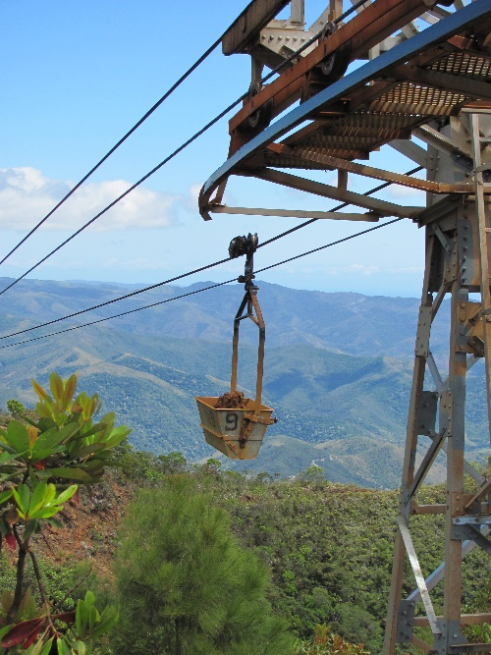
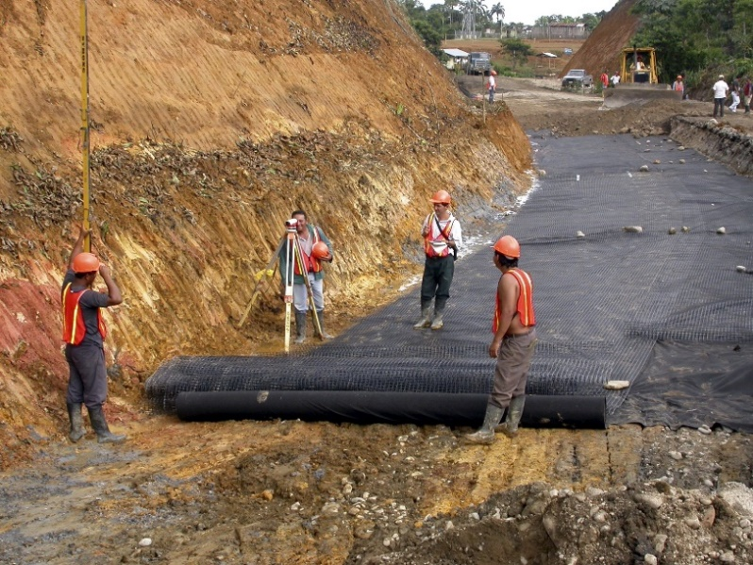
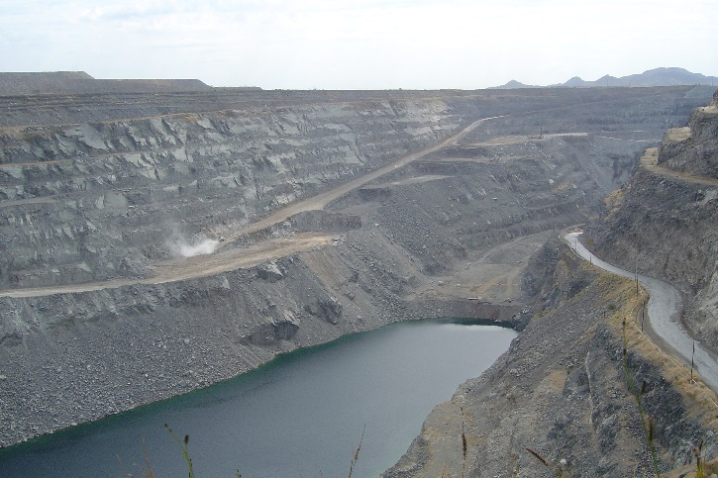

BBOP Resources
https://www.forest-trends.org/bbop/

Slide 24

Principles agreed by BBOP members
Adherence to the mitigation hierarchy
Limits to what can be offset
Landscape context
No net loss
Additional conservation outcomes
Stakeholder participation
Equity
Long-term outcomes
Transparency
Science and traditional knowledge
Notes:
* Principles.
One of the first things the BBOP members did was to agree a set of ten best practice principles for designing and implementing biodiversity offsets that all organisations could agree on. These 10 Principles were agreed and unanimously supported by full AG in 2009, they form the basis of high quality offsets. They emphasise the importance of following the Mitigation Hierarchy rigorously and only dealing with offsets as a last resort, but as a crucial part to deliver NNL. The highlights are:
• An offset must adhere to the MH and are undertaken after appropriate avoidance, minimization, etc. – they are not a substitute for these other mitigation measures.
• Pls recognize that there are limits to what impacts can be offset – for where a development project may impact highly vulnerable or irreplaceable biodiversity its unlikely or impossible for ecological reasons that NNL or NG can be achieved and offsets are not feasible. The most obvious example is one where impacts would cause the extinction of a species, but it can apply to highly irreplaceable or vulnerable biodiversity as well where gains will not balance out the loss.
• It is important to plan and design offsets within a landscape context – for example, to apply the MH to appropriately avoid impacts, as well as selecting appropriate sites where conservation activities can provide enough of the right kinds of biodiversity gains to balance losses in the long term.
• Offset must be EXPLICITLY designed to achieve at NNL and preferably a net gain – three conditions are central here – that losses and gains are quantified and comparable in type and amount of biodiversity, that gains are additional, and that risks are integrated into planning to ensure long-term outcomes.
• The conservation outcomes must be additional – they would not have occurred without the offset activities: broadly speaking there are two ways of generating biodiversity gains – through restoring biodiversity to improve its condition, and/or to implement conservation actions that can be demonstrated to avert current or future predictable losses.
• Stakeholder participation/engagement – crucial throughout the offset process – in undertaking the impact assessment, designing and implementing the offset. For example, one of the key aspects to take into account are people’s different values of biodiversity, and to ensure that these are represented – to address what people care about, whether its species of conservation concern, use and cultural values, particular ecosystem types, etc.
• Equity must be considered to ensure that costs and benefits are equitably shared among stakeholders so that there is support for the project and the offset from all sides.
• Long-term outcomes – this is crucial as, to achieve NNL, the conservation outcomes that constitute the offset need to last as least as long as the residual impacts, or preferably in perpetuity, and this means several different things need to be put in place, management arrangements, financing of the offset, etc..
• Last, transparency in planning, design, implementation and
• Underpinned by science and traditional knowledge are other integral parts of best practice.

Slide 25
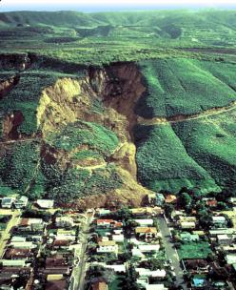
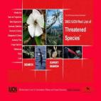

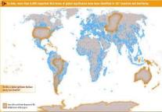
BBOP Principles
1. Adherence to the mitigation hierarchy:
A biodiversity offset is a commitment to compensate for significant residual adverse impacts on biodiversity identified after appropriate avoidance, minimization and on-site rehabilitation measures have been taken according to the mitigation hierarchy.
2. Limits to what can be offset:
There are situations where residual impacts cannot be fully compensated for by a biodiversity offset because of the irreplaceability or vulnerability of the biodiversity affected.

Slide 26
BBOP Principles: Landscape Context
3. Landscape context: A biodiversity offset should be designed and implemented in a landscape context. This is to achieve the expected measurable conservation outcomes, taking into account available information on the full range of biological, social and cultural values of biodiversity and supporting an ecosystem approach.
Early, individual offsets
Developed
Preserved
Unplanned
development
Sources: 2004: Insight/IUCN; White; Maze
Landscape-level planning
Developed
Preserved

Slide 27
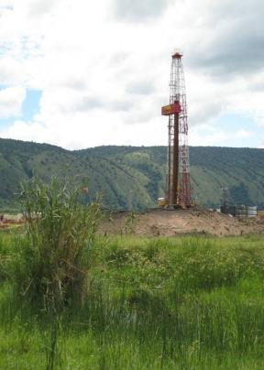

BBOP Principles
4. No net loss: A biodiversity offset should be designed and implemented to achieve in situ, measurable conservation outcomes that can reasonably be expected to result in no net loss and preferably a net gain of biodiversity.
5. Additional conservation outcomes: A biodiversity offset should achieve conservation outcomes above and beyond results that would have occurred if the offset had not taken place. Offset design and implementation should avoid displacing activities harmful to biodiversity to other locations.

Slide 28
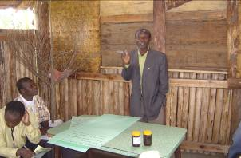
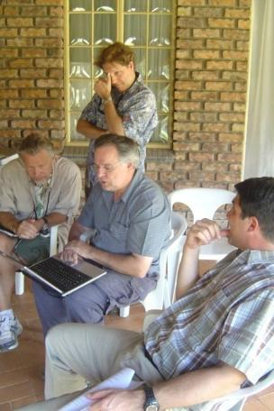

BBOP Principles
Stakeholder participation: In areas affected by the project and by the biodiversity offset, the effective participation of stakeholders should be ensured in decision-making about biodiversity offsets, including their evaluation, selection, design, implementation and monitoring.
Equity: A biodiversity offset should be designed and implemented in an equitable manner, which means the sharing among stakeholders of the rights and responsibilities, risks and rewards associated with a project and offset in a fair and balanced way, respecting legal and customary arrangements. Special consideration should be given to respecting both internationally and nationally recognised rights of indigenous peoples and local communities.

Slide 29
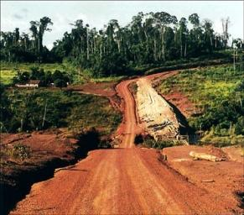


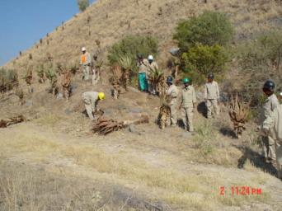
BBOP Principles
Long-term outcomes:
The design and implementation of a biodiversity offset should be based on an adaptive management approach, incorporating monitoring and evaluation, with the objective of securing outcomes that last at least as long as the project’s impacts and preferably in perpetuity.

Slide 30

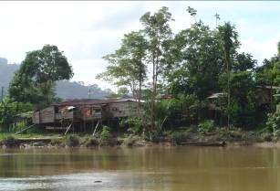
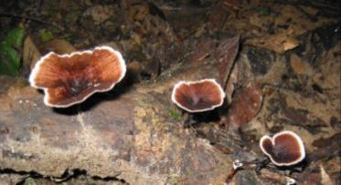
BBOP Principles
9. Transparency: The design and implementation of a biodiversity offset, and communication of their results to the public, should be undertaken in a transparent and timely manner.
10. Science and traditional knowledge: The design and implementation of a biodiversity offset should be a documented process informed by sound science, including an appropriate consideration of traditional knowledge.

Slide 31
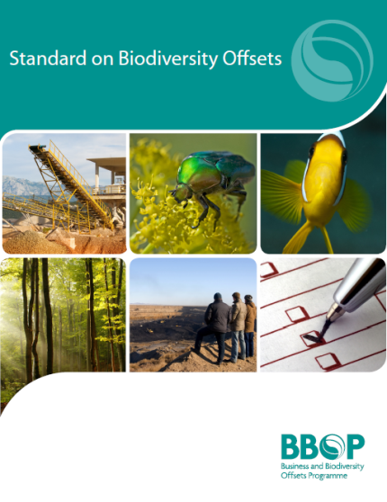
BBOP Standard on Biodiversity Offsets
To help auditors assess conformance with the BBOP standard.
To help companies design & implement offsets.
Fundamental statements about a desired outcome.
The conditions that need to be met to comply with a Principle.
Measurable states to tell whether or not a particular Criterion has been met.
Principles:
Criteria:
Indicators:
Guidance Notes:
Interpretation of Indicator
Key questions
Conformance requirements
Possible causes of non-conformance
…. Explains terms, concepts
…. What assessor needs to answer
…. To meet the standard
…. Examples of not meeting the standard

Slide 32









Final BBOP meeting
Working for Biodiversity Net Gain:
Taking stock and prospects for the future
Celebrating 15 years of BBOP
27 Nov 2018

Slide 33
A call to action
VISION: Appropriate development in the right place planned to achieve a net gain in biodiversity, undertaken with integrity to a high standard
GOVERNMENTS | COMPANIES | FINANCIAL INSTITUTIONS | CONSERVATION NGOs, ACADEMIA | CIVIL SOCIETY
National mitigation regulations: clear, well-governed feasible monitored & enforced in line with ambitious conservation targets. | Biodiversity and ecosystems services included early in planning, so still room to avoid and minimise. | Develop, adopt, enforce safeguards policies & performance standards for net gain. Work with companies to apply these. Greater transparency and disclosure. | Help establish the biodiversity targets, data, maps and metrics to underpin the net gain. | Hold governments, companies and financial institutions to account.
Conservation and development priorities aligned through timely land-use planning. Licenses for companies with best practice. | Commit to net gain of biodiversity. Roadmap to achieve this. Communicate progress & biodiversity outcomes transparently. | Donors finance governments to establish effective mitigation systems. Capacity building for public & private sectors. | Support companies and governments. Evaluate them independently. | Expect high standards and transparency about achievements of the promises made.

Slide 34
Standards
IUCN

Slide 35
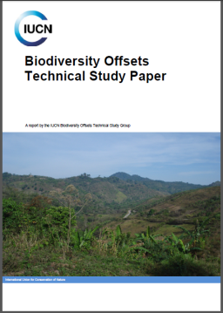
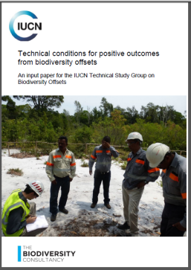
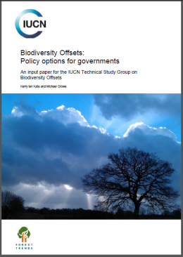
IUCN has adopted a policy on biodiversity offsets
This started with the Jeju mandate and objective
Resolution 110 , World Conservation Congress, Jeju 2012. Director General to establish a working group to develop IUCN policy on biodiversity offsets.
Objective: Guide strategic areas of technical engagement undertaken by IUCN and provide a framework for development of guidelines for IUCN members, government agencies, lenders, and the private sector
A Technical Study Group produced background papers
Technical and policy issues concerning biodiversity offsets, areas of general stakeholder convergence and unresolved issues and how might be addressed
Technical Study Paper: https://portals.iucn.org/library/node/44900
Input paper: technical conditions: https://portals.iucn.org/library/node/44900
Input paper: policy options https://portals.iucn.org/library/node/44776
Policy Working Group: Analysed policy options & proposed a draft policy to IUCN Council
IUCN policy was adopted by IUCN Council at the IUCN WCC, Hawaii 2016

Slide 36
IUCN policy statement on biodiversity offsetting
Under the specific conditions outlined, biodiversity offsets can contribute to positive conservation outcomes.
Only appropriate for projects which have rigorously applied the mitigation hierarchy and when a full set of alternatives to the project have been considered.
Governments should ensure mitigation hierarchy embedded in landscape and seascape level planning and legislation, and part of strategic development plans.
Biodiversity offsets should address the residual impact to achieve at least No Net Loss and preferably a Net Gain at the project level, compared to a reference scenario (without the project and the offset, or providing a better outcome for biodiversity).
Societal values should also be accounted for and inform the design and implementation of biodiversity offsets.
When residual impacts on biodiversity cannot be offset or offsets have a high risk of failure, biodiversity offsets are not appropriate, and the project as designed should not proceed.
Notes:
IUCN Policy statement: Under the specific conditions outlined in this policy, it is IUCN’s position that biodiversity offsets can contribute to positive conservation outcomes. However, biodiversity offsets are only appropriate for projects which have rigorously applied the mitigation hierarchy (avoid, minimise, restore/rehabilitate and offset; see section 6) and when a full set of alternatives to the project have been considered.
• Offsets must only occur after all previous steps in the mitigation hierarchy have been considered and no alternatives are available. Avoidance is the first and most important step in the mitigation hierarchy. Biodiversity offsets must never be used to circumvent responsibilities to avoid and minimise damage to biodiversity, or to justify projects that would otherwise not happen.
• The mitigation hierarchy must be applied at the landscape or seascape level with mitigation actions designed and implemented at a site or project level. Governments should ensure the mitigation hierarchy is embedded in the framework of landscape and seascape level planning and legislation and is part of existing and future strategic development plans.
• Only after applying the earlier steps in the mitigation hierarchy should biodiversity offsets be employed to address the residual impact in order to achieve at least No Net Loss and preferably a Net Gain at the project level. The terms No Net Loss or Net Gain refer to the outcome achieved compared to a reference scenario. This reference scenario can be what is likely to have occurred in the absence of the project and the offset, or one that provides a better outcome for biodiversity conservation. Societal values should also be accounted for and used to inform the design and implementation of biodiversity offsets.
• In certain circumstances, residual impacts on biodiversity (after completing the avoidance, minimization and rehabilitation steps of the mitigation hierarchy) cannot be offset. Additionally, there are some components of biodiversity for which impacts could theoretically be offset, but with a high risk of failure. Under these circumstances, biodiversity offsets are not appropriate, and this means the project as designed should not proceed.

Slide 37
IUCN policy: key elements of biodiversity offsets
IUCN’s policy states that further guidelines may be needed on:
Measuring and Exchanging Biodiversity
Additionality
Timeframe
Uncertainty
Monitoring and Evaluation
Governance

Slide 38
Module on Standards – Take home messages
Financial performance standards and loan conditions applied by financial institutions have been a major driver for developers to apply the mitigation hierarchy rigorously and plan for No Net Loss and Biodiversity Net Gain is the set of standards. All the standards stress avoidance as the vital first step with biodiversity offsets as the last resort.
International Finance Corporation Performance Standard 6 of the (IFC PS6), also adopted by 99 financial institutions in 37 countries which are members of the Equator Principles Association requires companies obtaining project finance to follow the mitigation hierarchy and plan for NNL/BNG.
The World Bank’s Environmental and Social Standard 6 takes a similar approach and stress the need for developers to involve a competent expert, prepare a Biodiversity Management Plan and take a differentiated approach to risk management for ‘natural’, ‘modified’, ‘critical’, ‘protected’ habitats and species.
The Business and Biodiversity Offsets Programme (BBOP) was a global, multi-stakeholder programme comprising 100 companies, financial institutions, government agencies, NGOs, research organisations, individuals helping develop and apply best practice on NNL/BNG through the mitigation hierarchy. Available resources include BBOP’s Principles & Standard on Biodiversity Offsets, a Roadmap for Business, a Roadmap for Government, Handbooks on mitigation design and implementation, Resource Papers on a variety of related subjects and case studies, as well as many online webinars and a library.
IUCN’s policy on biodiversity offsets states that biodiversity offsets can contribute to positive conservation outcomes under defined conditions. It covers rigour in the mitigation hierarchy, consideration of alternatives, landscape and strategic planning and social values. And it describes situations where offsets are not appropriate because impacts cannot be offset or offsets risk failure.

